Slide 1
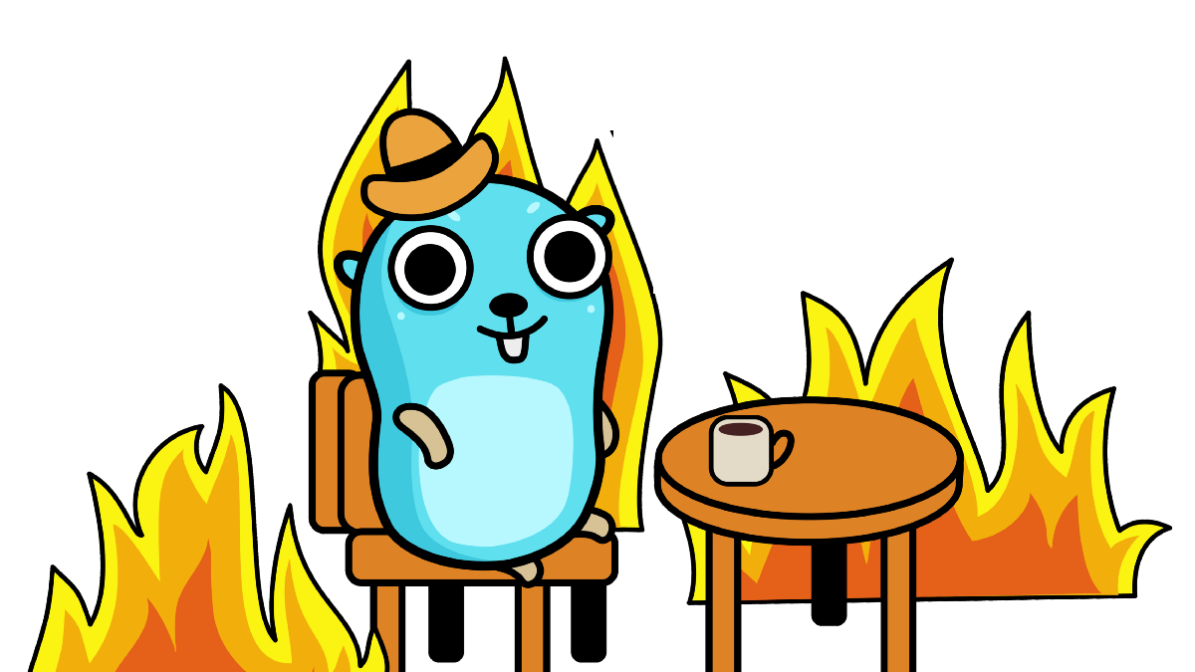

Golang Concurrency Bugs
Gufran Mirza
gufranmirza

Slide 2
What this talk is about
Different types Concurrency Bugs Golang
Common pitfalls while writing concurrent programs in Golang
Solutions to some of common concurrency Bugs

Slide 3
Contents
Concurrency in Golang
Blocking Bugs
A blocking bug caused by WaitGroup
A blocking bug caused by context(ctx)
A blocking bug due to wrong usage of channel with lock
QnA

Slide 4
Concurrency
How Concurrency is achieved in Golang
In Go, concurrency is achieved by using Goroutines
Golang runtime takes care of creating actual threads and scheduling of goroutines
Goroutines != threads
Goroutines uses channels to communicate safely between themselves

Slide 5
Blocking Bugs
What are the Blocking Bugs ?
When one or more goroutines conduct operations that wait for resources, and these resources are never available
If this happens, you program will wait indefinitely for resources to become available
Caused by misuse of Mutex, WaitGroup and Channels etc.

Slide 6
Blocking Bugs
1. A blocking bug caused by WaitGroup
Waiting on cond.Wait(), until signal is received
Never received expected cond.Signal() from goroutines
Goroutines panicked, or you forgot call cond.Done() in it
Most likely to happen due to misplacement of wg.Add(), wg.Done(), wg.Wait()

Slide 7
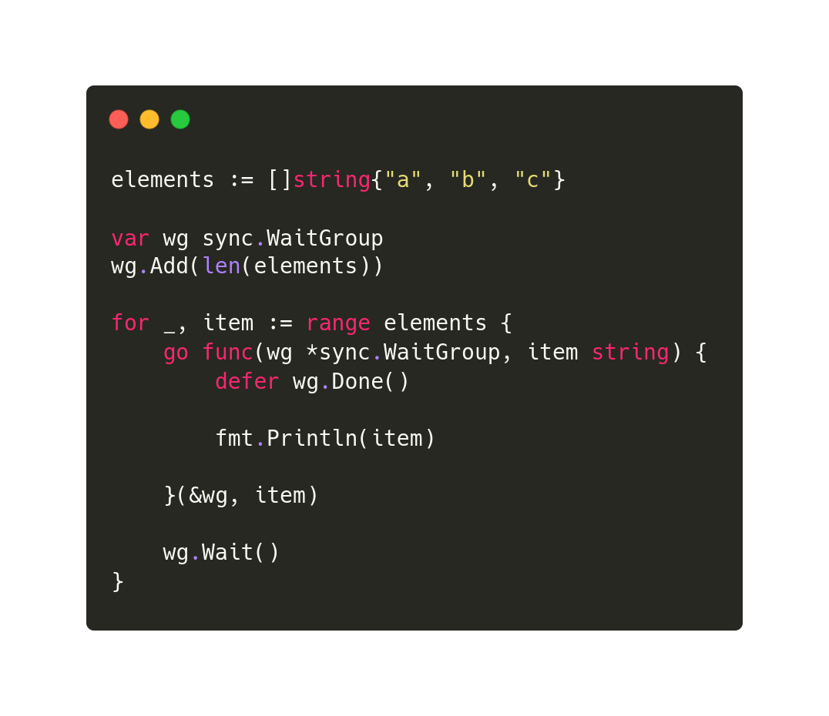
Blocking Bugs

Slide 8
Blocking Bugs
2. A blocking bug caused by context(ctx)
Waiting on ctx.Done(), until signal is received
Never received expected ctx.Signal() from goroutines
Goroutines panicked, or you forgot call ctx.CancelFunc() in it
likely to happen if context is never cancelled(timedout)

Slide 9
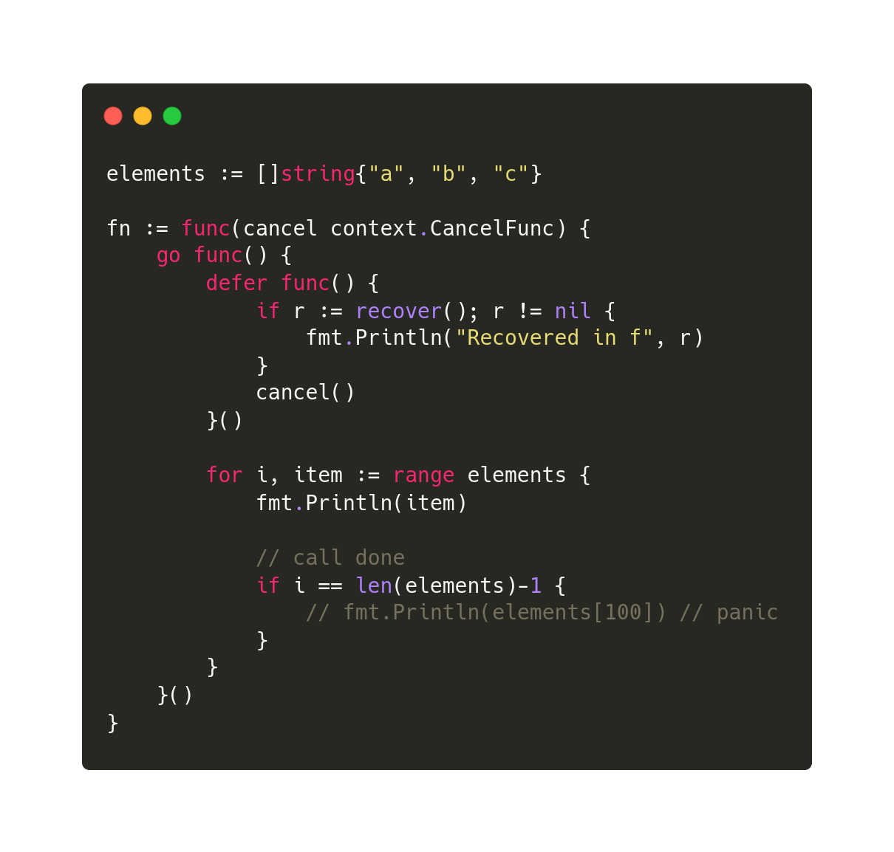
Blocking Bugs

Slide 10
Blocking Bugs
3. A blocking bug due to wrong usage of channel with lock
Waiting on receive channel, until signal is received
Waiting to acquire a Lock on the resource
Goroutines panicked, or you forgot call mutex.Unlock(), or channel never signaled <- struct{}{}

Slide 11
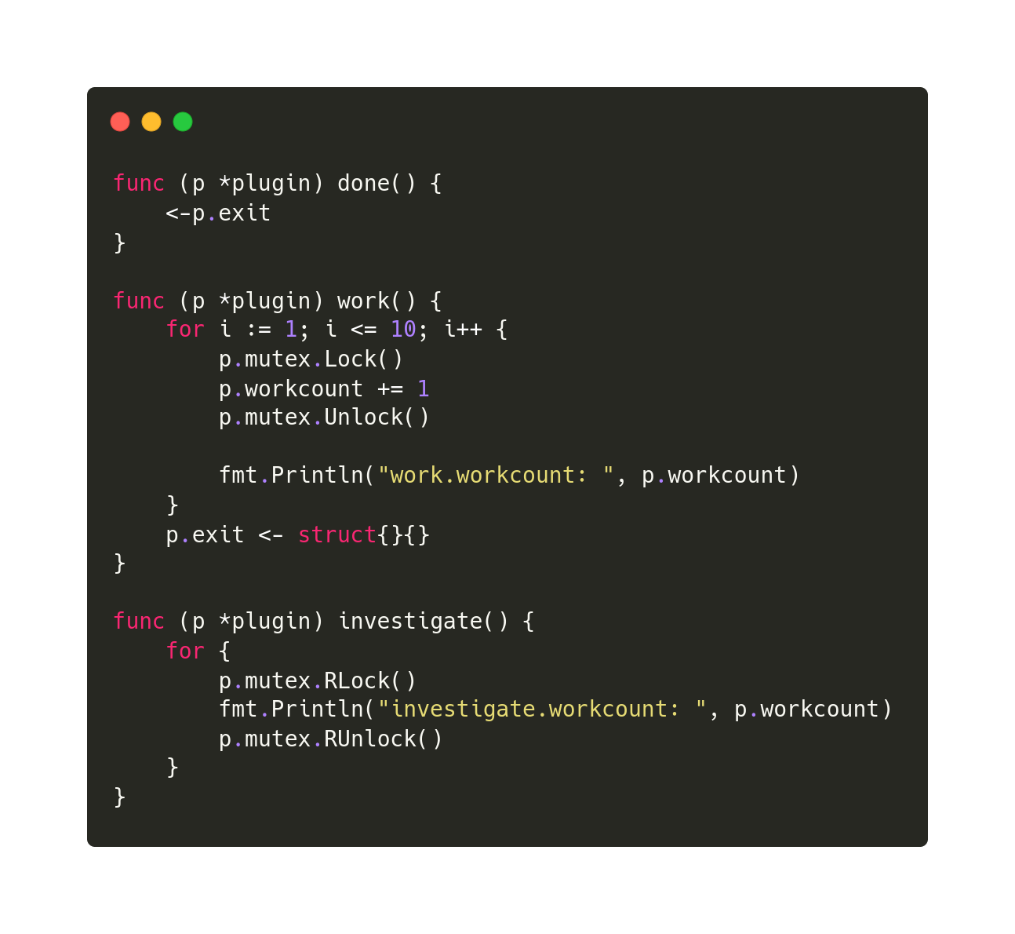
Blocking Bugs

Slide 12
References
References
Credits
https://songlh.github.io/paper/go-study.pdf
Github Repo
https://github.com/gufranmirza/talks/tree/main/2022/02-golang-concurrency-bugs

Slide 13

Questions
Questions…?

Slide 14




Contact me
Gufran Mirza
Software engineer @IBM Cloud
@_imGufran
@gufranmirza
gufranmirza.com

